Slide 1
PHYS60022 Data Science and Machine Learning for Physics
Week 9: Neural Networks
Patrick Dunne, p.dunne12@imperial.ac.uk

Slide 2
Learning Outcomes
Learning outcomes for today
Introduce the concept of neural networks
Learn the principles of neural network training
Know how to make basic choices of architecture including which activation function to use
Know how to use pytorch to set up and train a neural network

Slide 3
Biological inspiration
Credit to Jarvist Moore Frost for this section

Slide 4

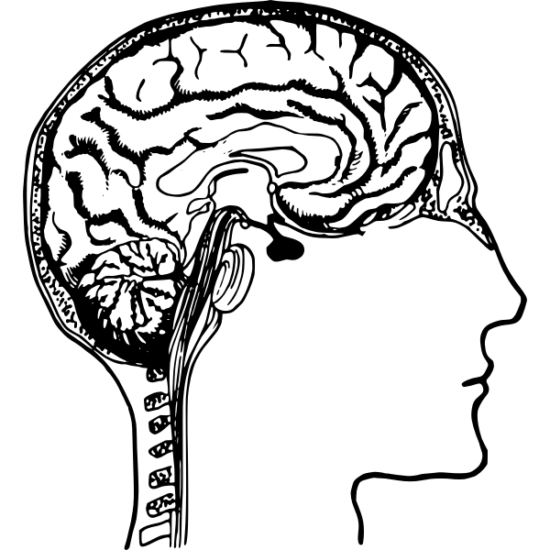
Biological Inspiration
"Anatomy and Physiology" by the US National Cancer Institute's Surveillance, Epidemiology and End Results (SEER) Program .
Neurons have multiple inputs / outputs
Relatively (!) simple functional relationship
86 billion neurons ⇒ human brain
0.1 million neurons ⇒ fruit fly Drosophila (fully imaged 2020)

Slide 5
Biological Inspiration

Slide 6

Biological Inspiration: Memory

Slide 7
Associative, extrapolative, memory
Vs. address based memory in a library / computer.

Slide 8


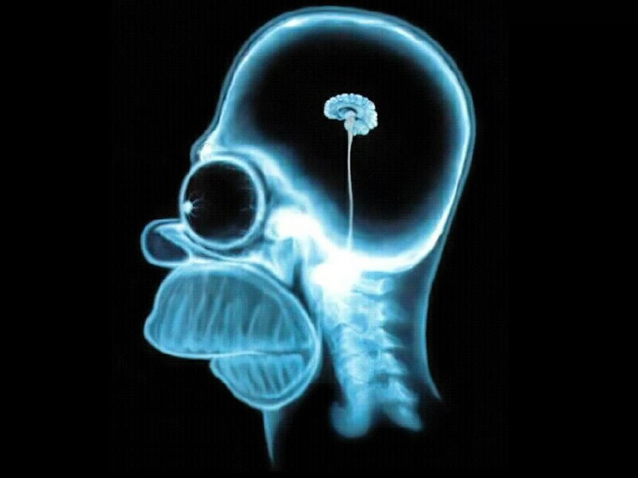

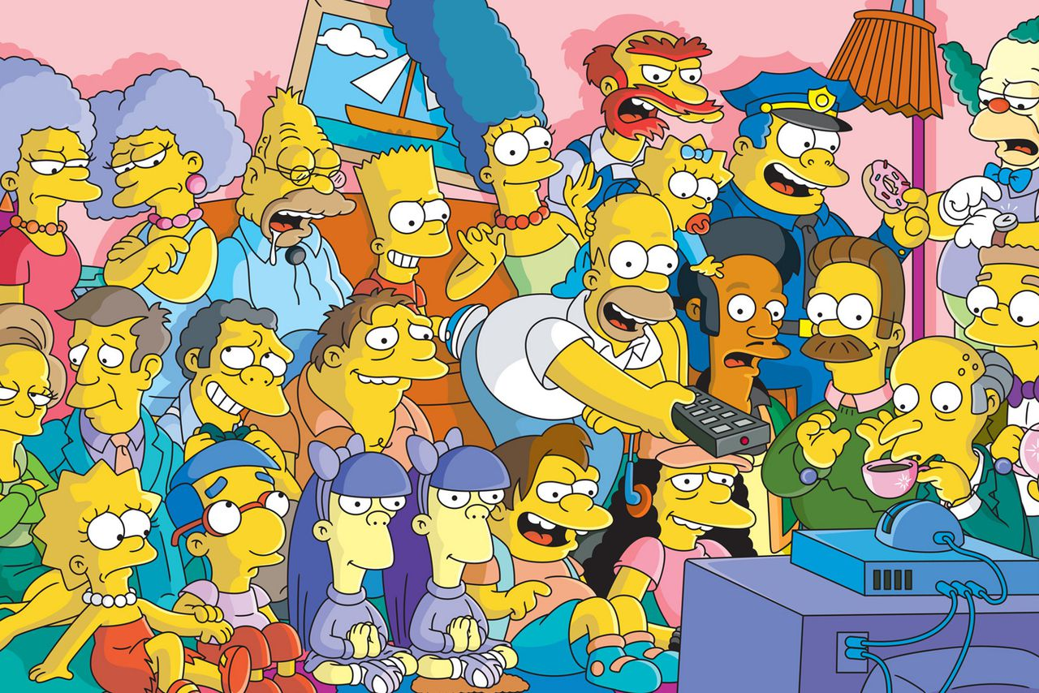

Spontaneous Recall

Slide 9
Human Perception: Fault Tolerant
Yuo cna porbalby raed tihs esaliy desptie teh msispeillgns.

Slide 10
Human Perception: Fault Tolerant
How about this?
The sprehas had ponits and patles

Slide 11
Human Perception: Fault Tolerant
How about this?
The sherpas had pitons and plates.
The shapers had points and pleats.
The seraphs had pintos and petals.
The sphaers had pinots and palets.
The sphears had potins and peltas.
https://www.mrc-cbu.cam.ac.uk/people/matt.davis/cmabridge/
I wonder if AI might ever do something like that?

Slide 12
Biology into Code

Slide 13
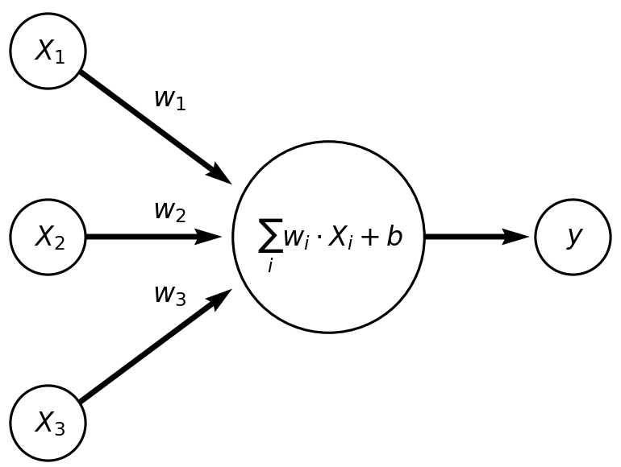
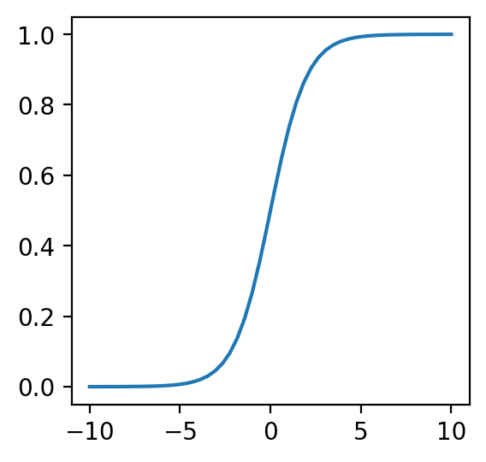
Biology → code
Abstract (and vastly simplify!) neuron behaviour to a linear sum plus some non-linear activation
Neurons that add all inputs together like this are called ‘linear layers’
We’ll see other types of layers next week
=
+

Slide 14
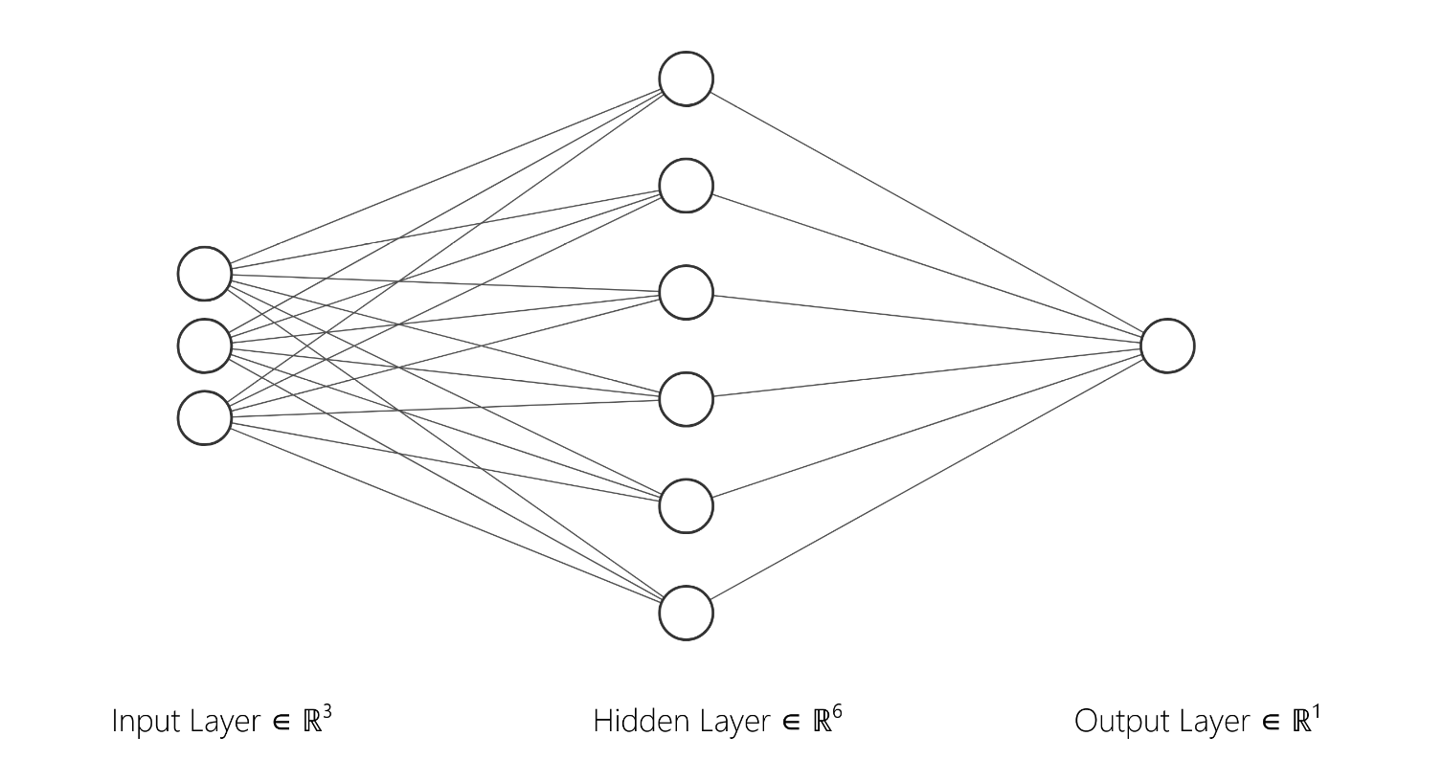
Multilayer neural networks
Universal function approximation theorem says that a complicated enough network of these units can approximate any function!

Slide 15
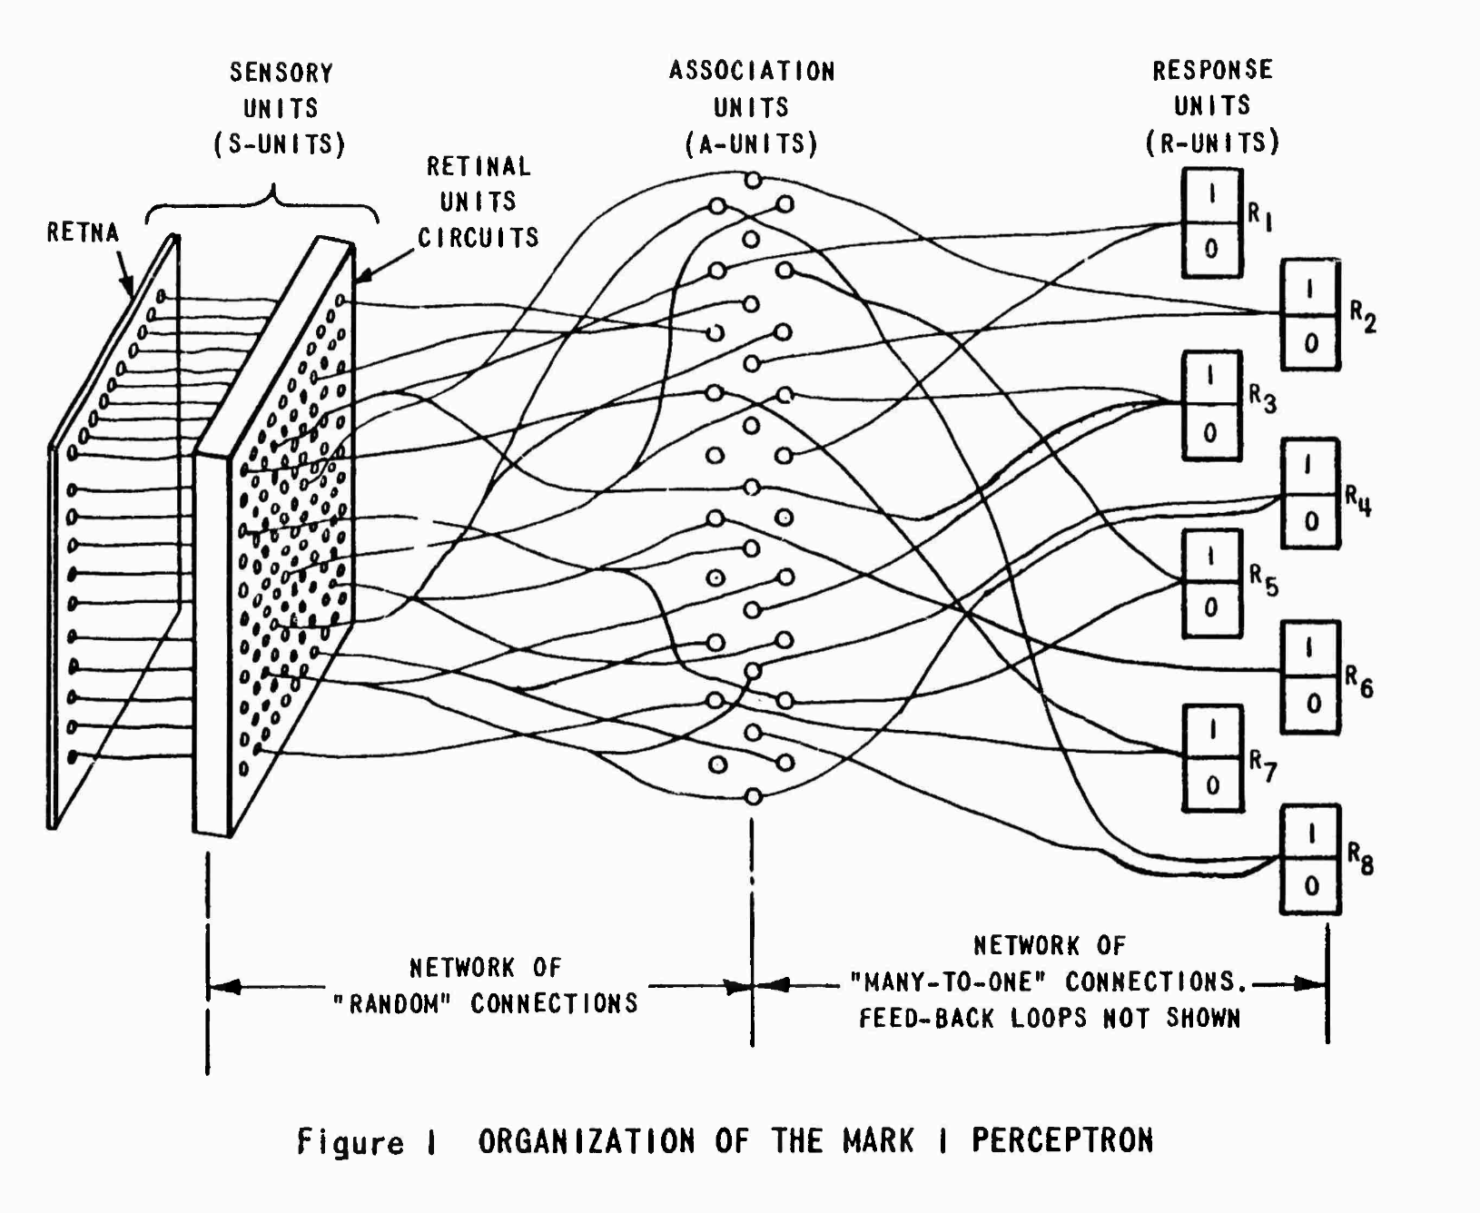
The Mark 1 Perceptron (1957>)
20x20
CdS photocells

Slide 16
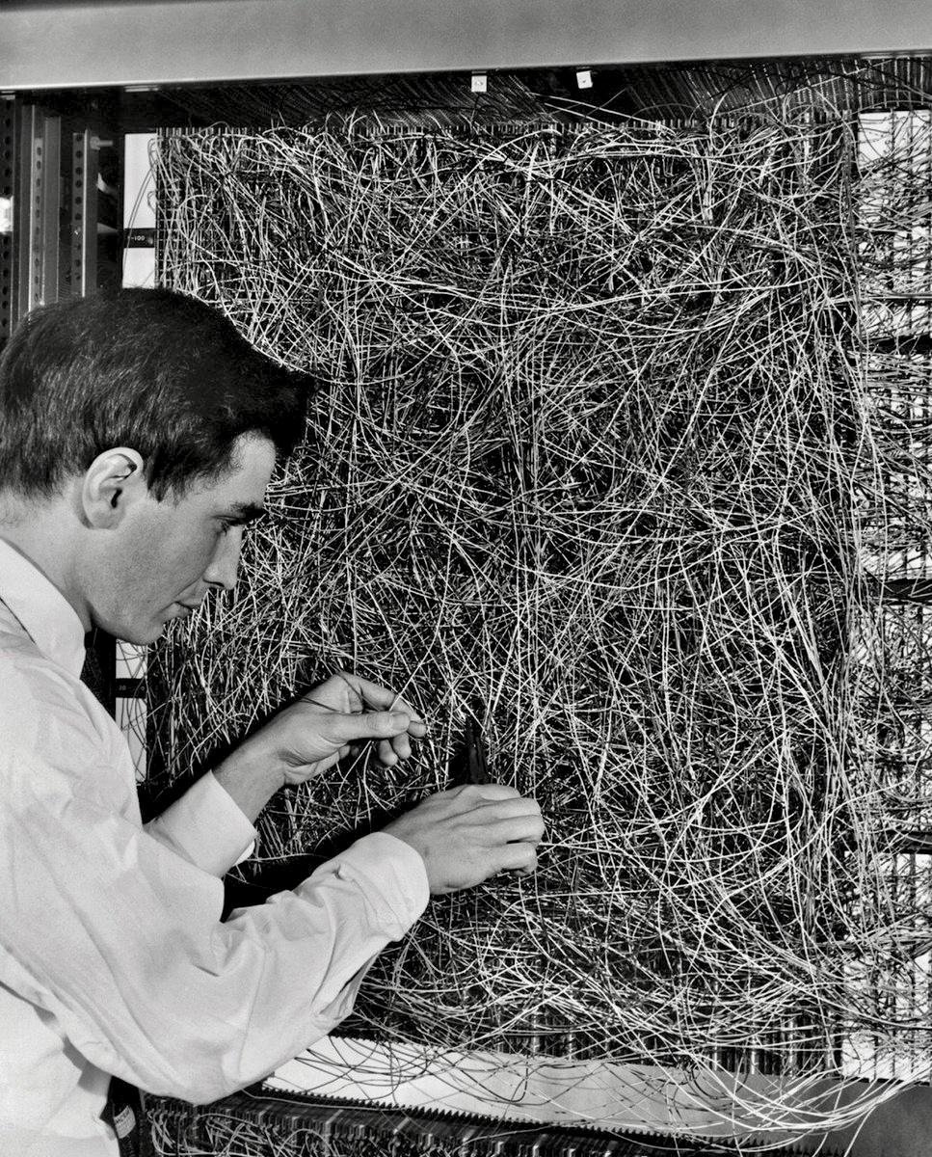
Frank Rosenblatt, with the 'feature selector' input patch

Slide 17
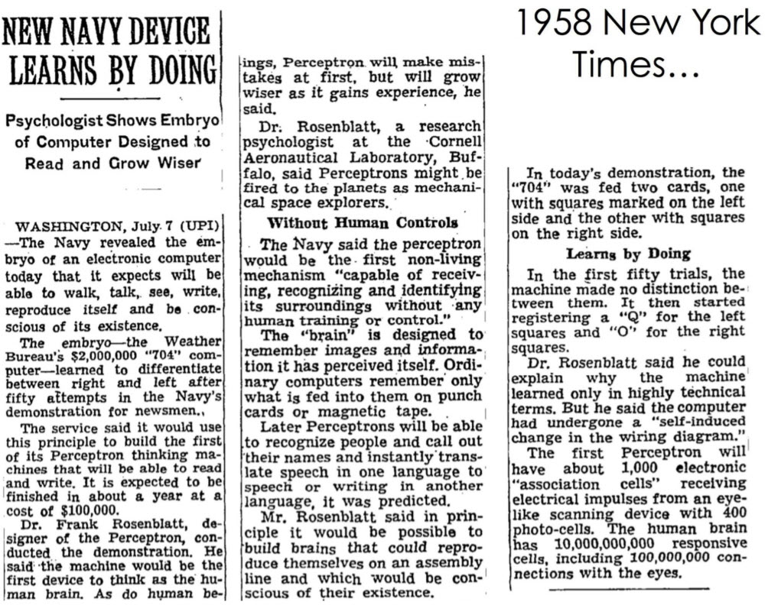
New York Times, July 8th 1958
What have we been doing since?
Partly waiting for faster computers
Partly needed to solve fundamental issues with method

Slide 18
Modern Neural Networks

Slide 19
Multilayer neural networks
First layer: Input layer
One neuron for every input feature
Not a linear combination of anything
Typically don’t have activation function applied
Last layer: Output layer
Often only one neuron but could be e.g. an image with one neuron per pixel
Usually do apply activation to combination of inputs
Hidden layers:
Where most of the work is done
Allow us to find new representations of the data
Why do we have to have non-linear activation functions?

Slide 20
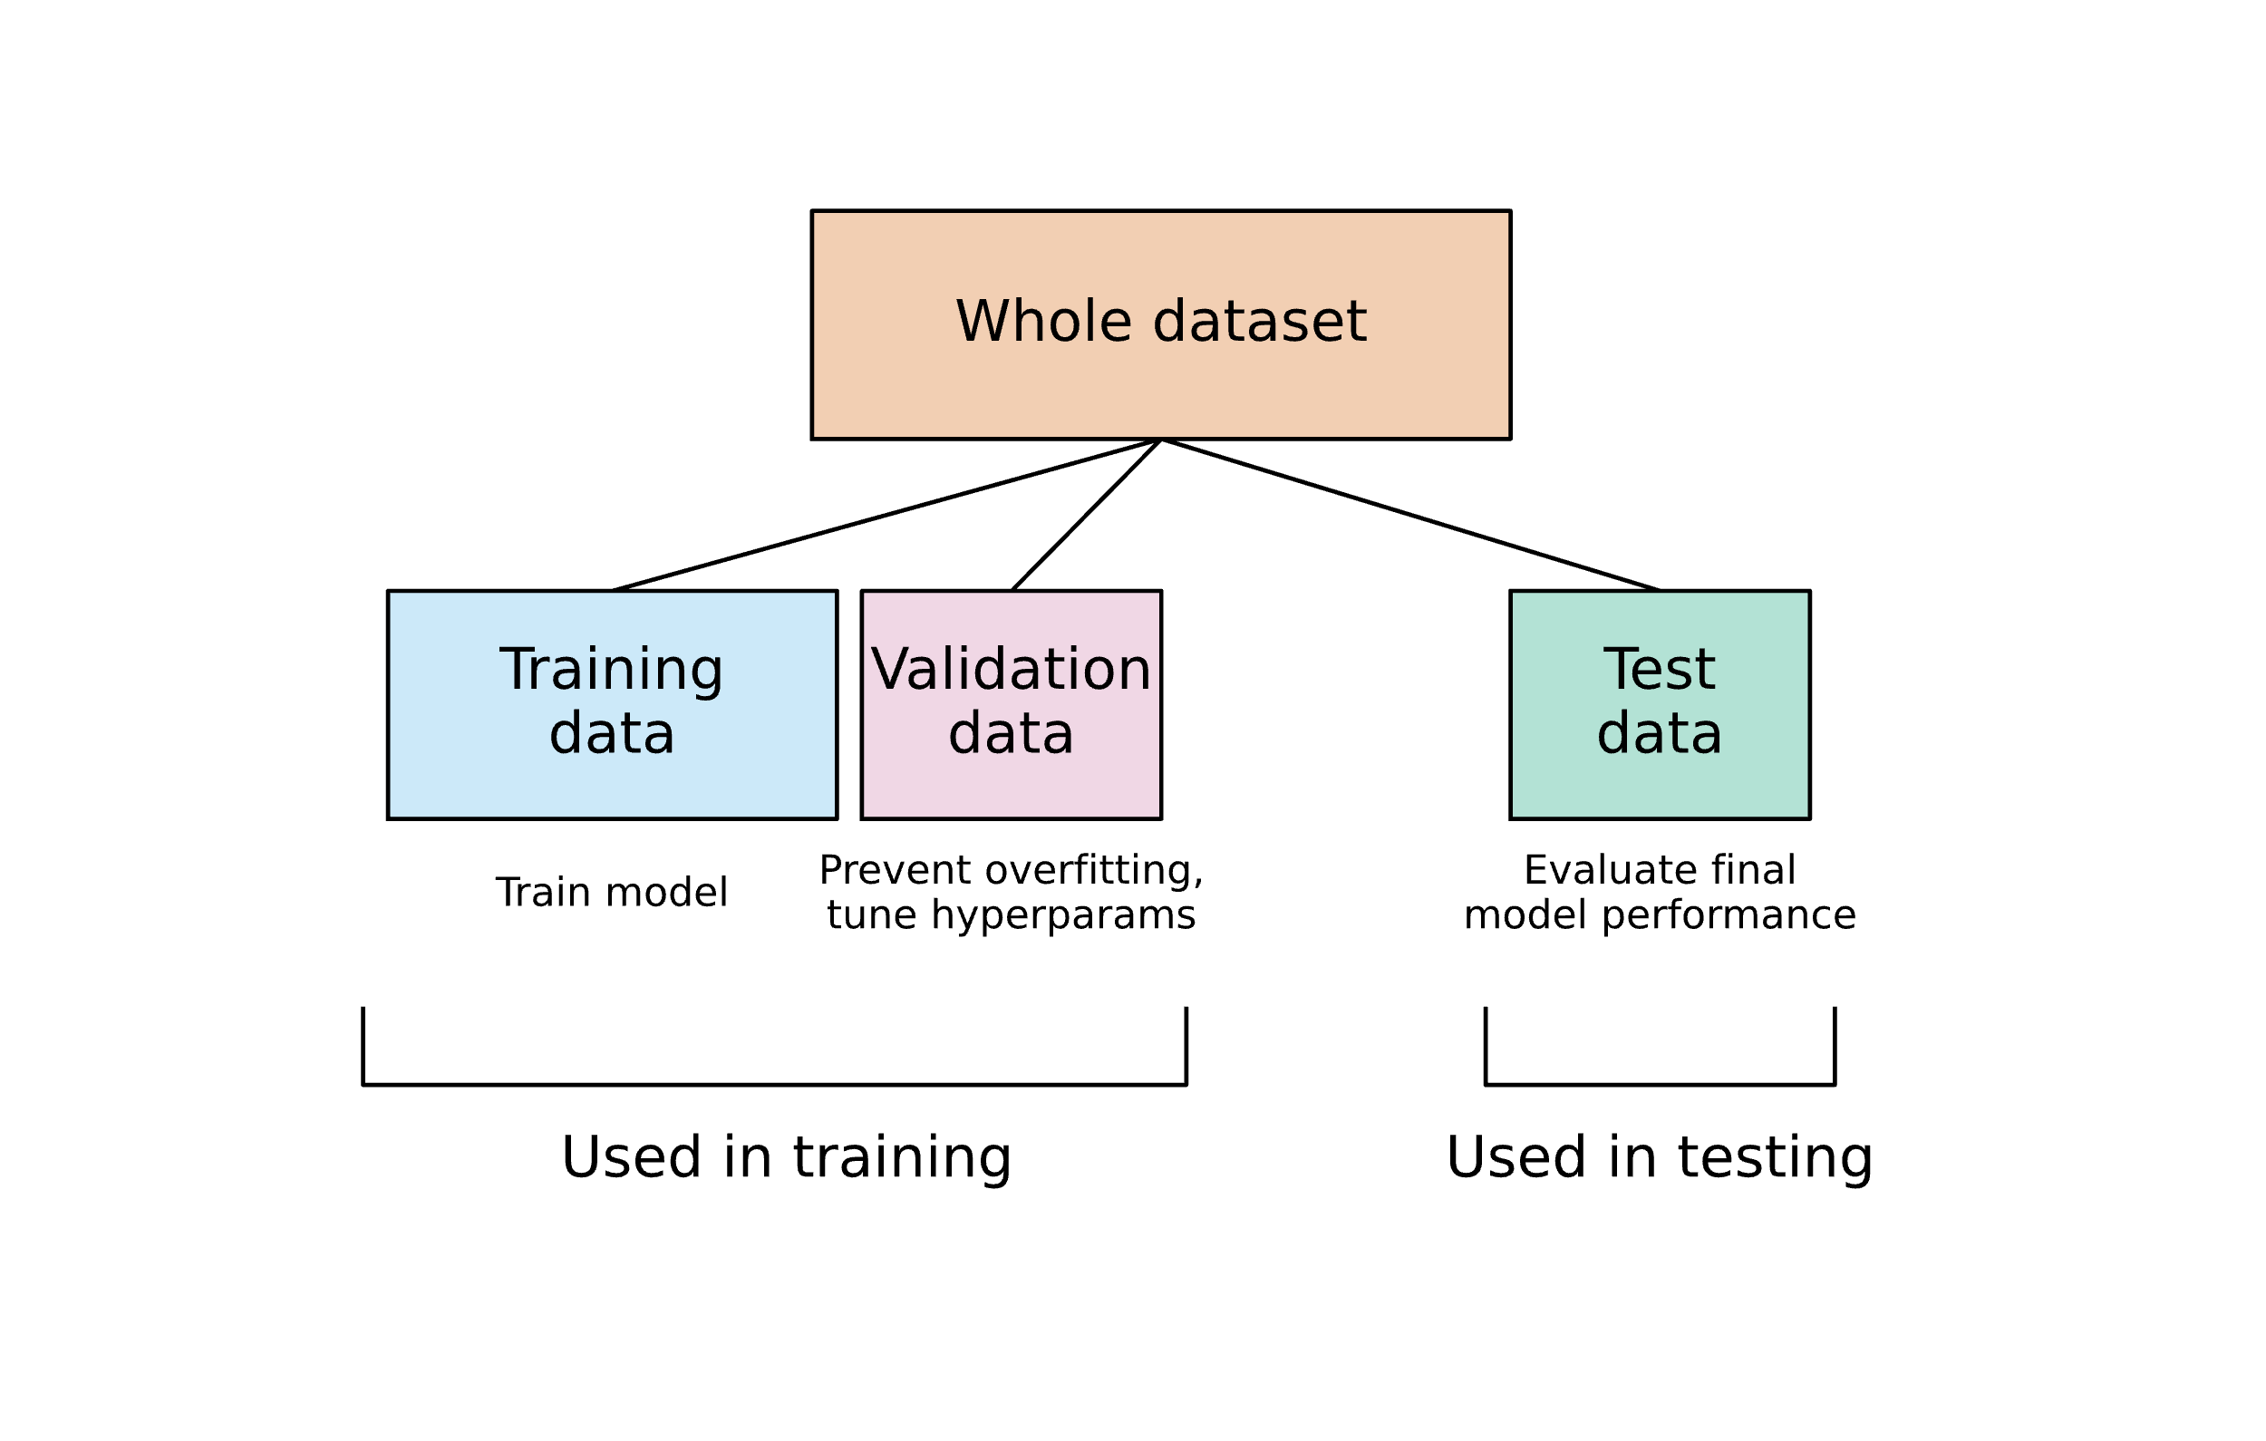
Training Neural Networks
Splitting data
So far we have usually split data into train and test
Model fitting and hyperparameter tuning done on train data, check for overfitting on test data
Neural networks involve a lot more fitting and many more architecture choices than other algorithms we’ve seen
Normal to split data into three categories
Training data: same function as before
Validation data: used to check for overfitting while tuning hyperparameters
Test data: test final model performance is what you expect after hyperparameter tuning

Slide 21
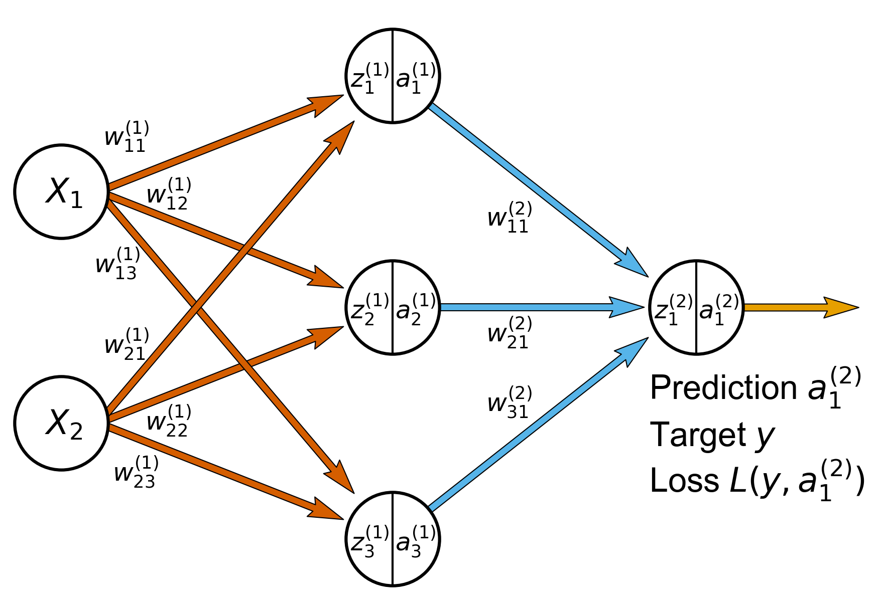
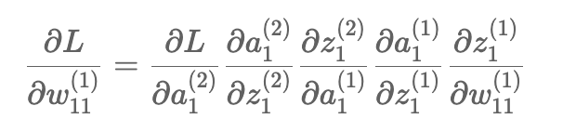
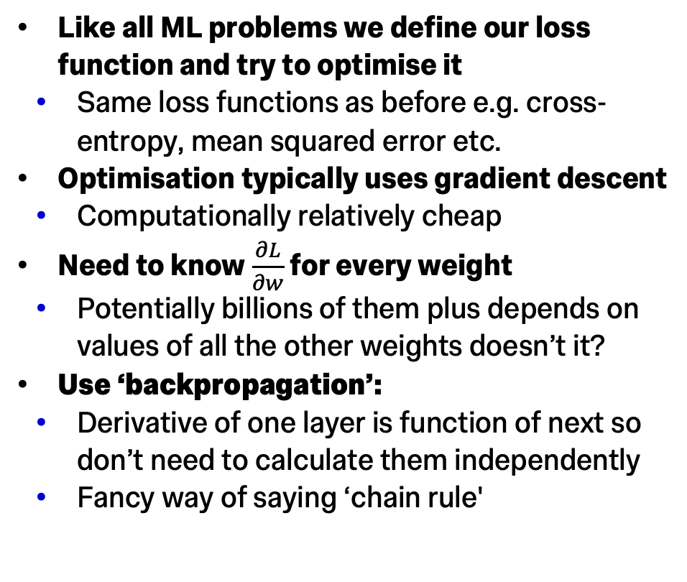
Training Neural Networks
Choosing values for all those weights?!
Like all ML problems we define our loss function and try to optimise it
Same loss functions as before e.g. cross-entropy, mean squared error etc.
Optimisation typically uses gradient descent
Computationally relatively cheap
Need to know $\frac{∂L}{∂w}$ for every weight
Potentially billions of them plus depends on values of all the other weights doesn’t it?
Use ‘backpropagation’:
Derivative of one layer is function of next so don’t need to calculate them independently
Fancy way of saying ‘chain rule'

Slide 22
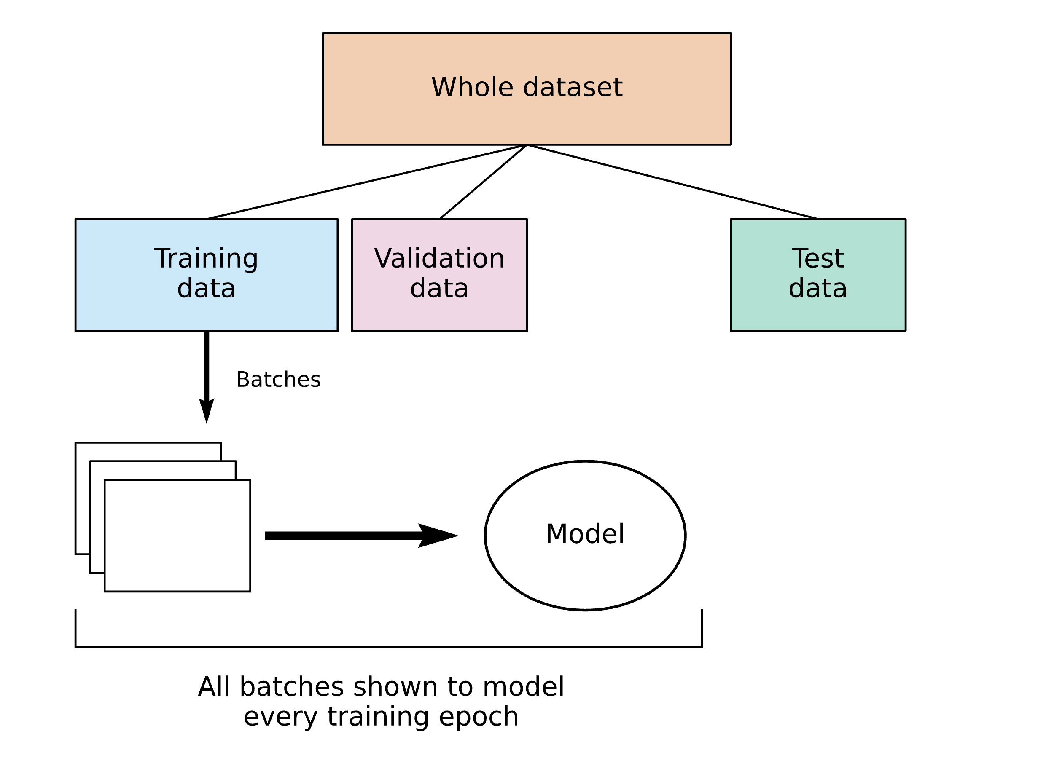
Training Neural Networks
Choosing values for all those weights?!
Gradient descent works by calculating gradients and stepping in that direction
Weighted by learning rate ⍺
What if you have many many training data members?
Each gradient step takes a long time
Training will be very slow
Stochastic gradient descent addresses this by splitting training data into many batches
Each batch is used to calculate a step so you get a lot more steps per full pass over training data (full pass called an epoch)
Batches are random and re-shuffled every epoch hence stochastic

Slide 23

Pytorch
We have covered a lot of steps needed to train a neural network
All need to be done many many times so must be efficient
Coding any of this by hand would take a long time and you’d probably make it too slow!
PyTorch is a library designed to implement any ML model involving gradient calculation
Automatically keeps track of gradients if you define model using its classes
You will be expected to use this package for any networks trained in the final test
Examples in notebook (quick demonstration now)

Slide 24
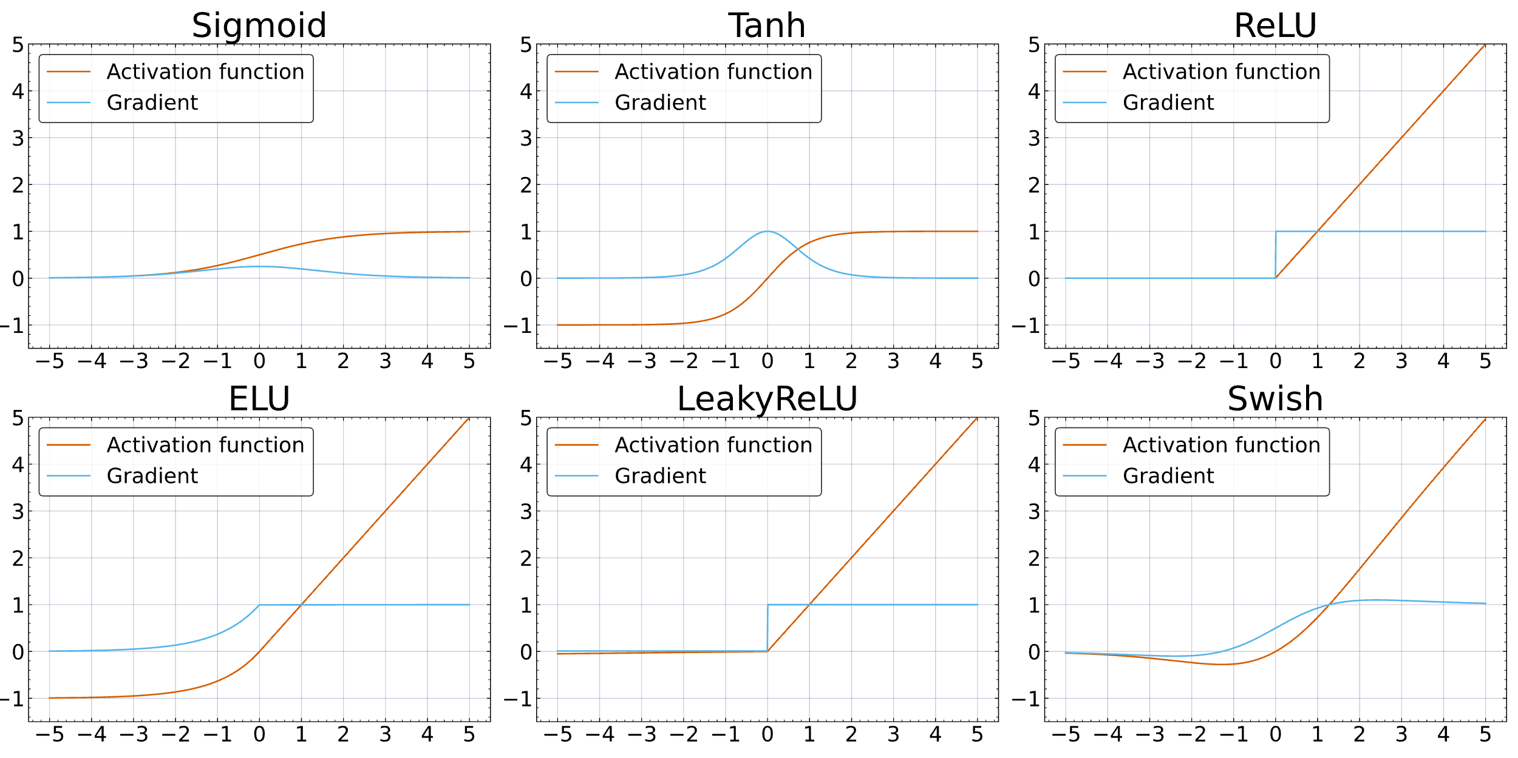
Choice of Activation Functions
Gradients that we’re calculating are basically products of many activation function derivatives
If gradient of our activation function isn’t ~1 raising it to a large power will lead to either:
Vanishing gradient problem 0.1²⁰ = 10⁻²⁰
Exploding gradient problem 10²⁰ = 10²⁰

Slide 25
Choice of Activation Functions
Large/small values are not just difficult to calculate, also need very different learning rates at different depths through the chain
Explosion of number of hyperparameters too!
Aiming for stable ~1 gradient that is fast to calculate
ReLU or rectified linear unit is perfect
Differential is a trivial step function
Migration to ReLU-based activation functions allowed the ‘deep learning’ jump of the early 2010s
See notebook for improvements to ReLU

Slide 26
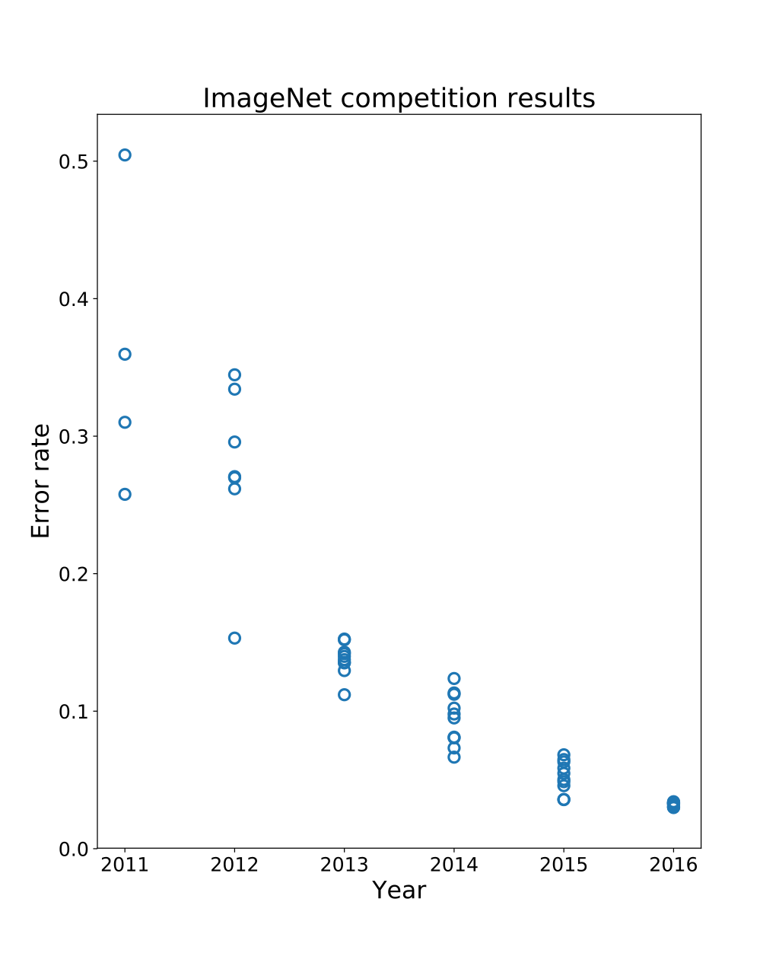

AlexNet,
A deep convolutional neural network,
16% error
In 2012 neural networks mostly solved computer vision
(Imagenet = 14 million annotated images.)

Slide 27
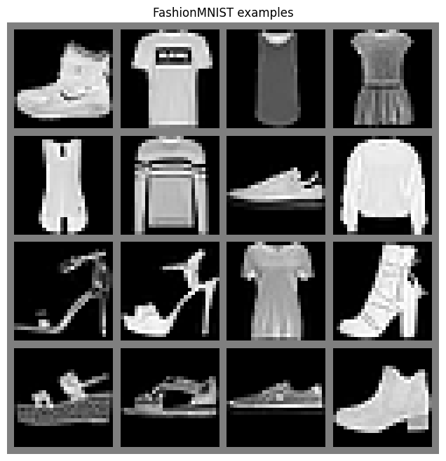
Exercises
New dataset for this week is FashionMNIST
Like MNIST but with higher resolution and clothes instead of numbers
Apply skills to this and other datasets we’ve seen already
Even if you’ve done neural networks before you need to learn how to do them using pytorch for this course

Slide 28
Exercises!

Slide 29
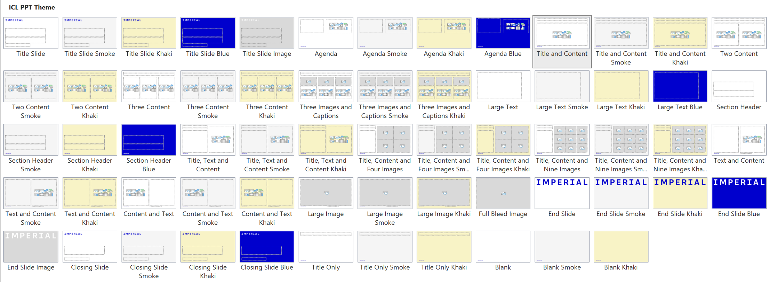
Notes to the template
Custom layouts and example slides
The template includes a range of predefined layouts that you can insert. These have been designed to cater for text, text and images and for picture arrangements. There are also layouts for Title and Divider slides.
Each custom layout includes the correct colour palette, type levels and formatting.
You can choose one of the layouts using the ‘New Slide’ button on the Home tab. You can also change the layout for a current slide using the ‘Layout’ list on the Home tab.

Slide 30
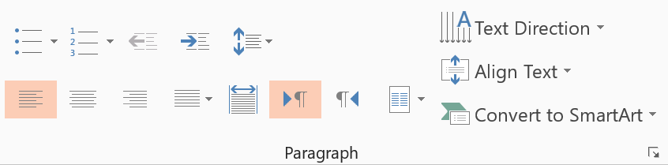
Notes to the template
Type levels and bullets
The standard text area has five predefined type levels.
You can move up or down the levels using the increase or decrease indent buttons in the home tab.
We recommend that you do not use the bullet button, as this does not apply the correct bullet formatting.
Level one is for general text
Level two is for subheadings within body copy
Level three is the first level of bullets
Level four is the second level of bullets
Level five is the third level of bullets
While text boxes are formatted to be the correct font, size, and colour, they will not contain the levels as a placeholder does. Therefore, it is recommended that you copy an existing text placeholder on the slide if you would like to insert a text box, to preserve the use of these levels.
Decrease list level
Increase list level

Slide 31

Notes to the template
Using picture slide layouts
The picture slides are predefined with picture placeholders that help you to manage the image you add into the field.
Click the button in the middle of the field to select and import the picture you want to use. The picture field will automatically fill the field with the image.
You can edit the position of the image using the crop tool, which is in the ‘Picture Tools > Format menu. This menu appears when you click on an image.
The crop tool allows you to enlarge, adjust position or crop the image to fit.

Slide 32

Notes to the template
Applying images to backgrounds
If you insert a Title or End Slide Image layout, you will find that the background is filled with a solid grey. This means that you can insert your own image to the background.
The first step is to right-click the background and choose Format Background – this will open a panel on the right of the screen.
Then, tick the Picture or texture fill box, and choose Insert Picture from File. Select an image from your computer, ensuring it follows brand guidelines, and the picture will automatically fill the background of the slide.

Slide 33
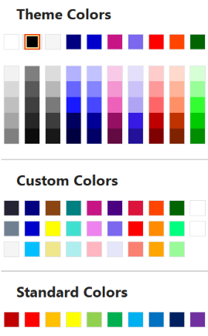
Notes to the template
Tips and recommendations
Type levels
Always use the type levels in the predefined content placeholders, supplied with each layout.
Text boxes
If you use text boxes, please note that they do not include the type levels. Any formatting has to be manually applied, and we recommend you adhere to the brand rules.
Footers
The footer and page number can be modified and turned on or off. To do this, go to the Insert tab on the ribbon, then click Header and Footer.
Colour palette
Always select a colour from the supplied colours.
The top row represents the correct brand colours and are automatically used in charts and diagrams.
The Custom Colors section contains all of the brand colours, some in multiple tints. Please use these as required.
The Standard Colors row is supplied by Office and does not follow brand guidelines. Please do not use these colours in your documents.

Slide 34
Thank you
Presentation Title
DD/MM/YYYY

